Slide 1

Retail Sales analysis Data analytics capstone project Excel | SQL | Python | Power BI
Presented by :Sarumathi u

Slide 2
introduction
Deployed retail analytics system via SQL, Excel data, Python, and Power BI.
Analyze sales, orders, customers, products, and segments of customers.
Interactive dashboard assists in monitoring KPIs and detecting growth potential.

Slide 3
Problem Statement
Retail data is generated across sales, customers, products, stores and staffs.
Analyzing these data sources separately makes it difficult to get a complete view of business performance.
There is a need for a structured analytics approach to identify sales trends, customer behaviour and operational issues.

Slide 4
Project Objectives
Calculation of KPIs for sales: revenue, orders, customers, average order value.
Analysis of performance of products and categories and their top contributors.
Segmentation of customers based on purchasing behavior.
Filtering and visualization on the dashboard for quick decision-making.

Slide 5
Data & Technology
Data Set for customer segmentation: 1,445 observations and 5 variables. Workbook order-items: Brands, Order items, Category details, Orders, Stocks, Stores, Staffs, Products.
SQL project is utilized for querying, joining, aggregating, and data preparation.
Python project is to getting the Customer Segment datasets and Viewing the graph chart using pandas, seaborn and matplotlib.
Power BI is used for data modelling, DAX measure, visualization, and dashboard report.

Slide 6
Excel: Data Preparation
Cleaned and standardized the raw data
Handled missing / inconsistent values
Applied lookup and calculation functions
Performed initial analysis using Pivot Tables
Prepared the data for database analysis

Slide 7
MySQL: Data Analysis
Imported the cleaned data into relational tables
Worked with tables such as orders, customers, products, stores and staff
Used JOINs to combine related data
Applied aggregations and business queries
Analyzed:
Sales performance
Top-selling products
Customer purchases
Staff performance
Low-stock products
Prepared the customer segments table from Python-based segmentation results

Slide 8
Python: Exploratory Data Analysis
Extracted data from MySQL using Python
Used Pandas for data preparation & analysis
Performed EDA to identify patterns and trends
Analyzed sales, customer and order behaviour
Performed RFM-based segmentation and visualization

Slide 9
Power BI: Dashboard & Visualization
Integrated the analyzed retail data into an interactive dashboard
Presented sales, product, customer and operational performance in one view
Used KPIs, filters and interactive visuals to explore the data
Enabled quick identification of sales trends, top products, customer patterns and stock issues
Interactive dashboard for monitoring retail performance and business insights

Slide 10
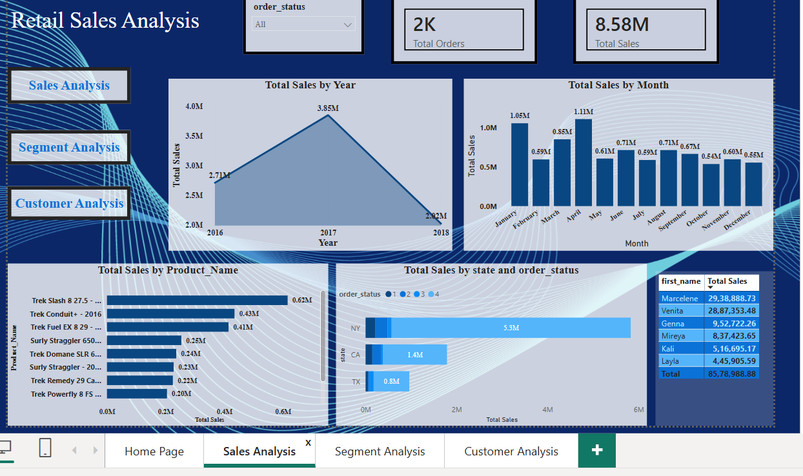

Slide 11
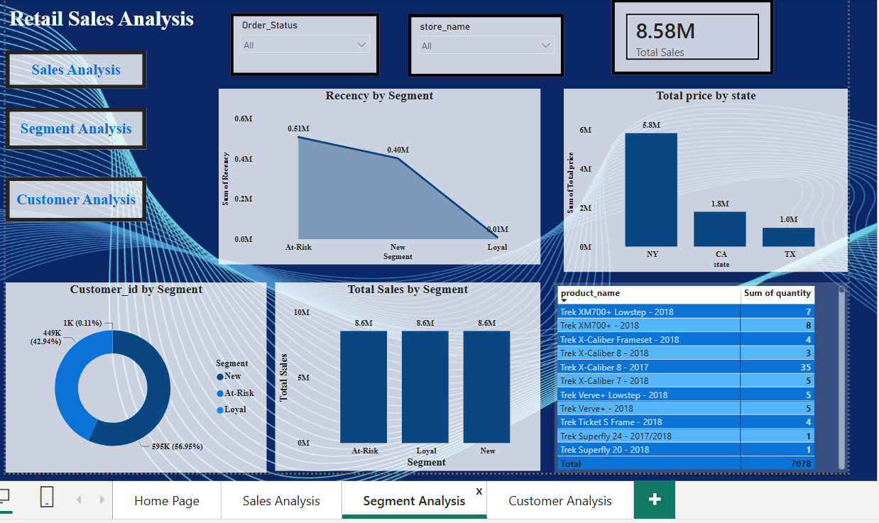

Slide 12
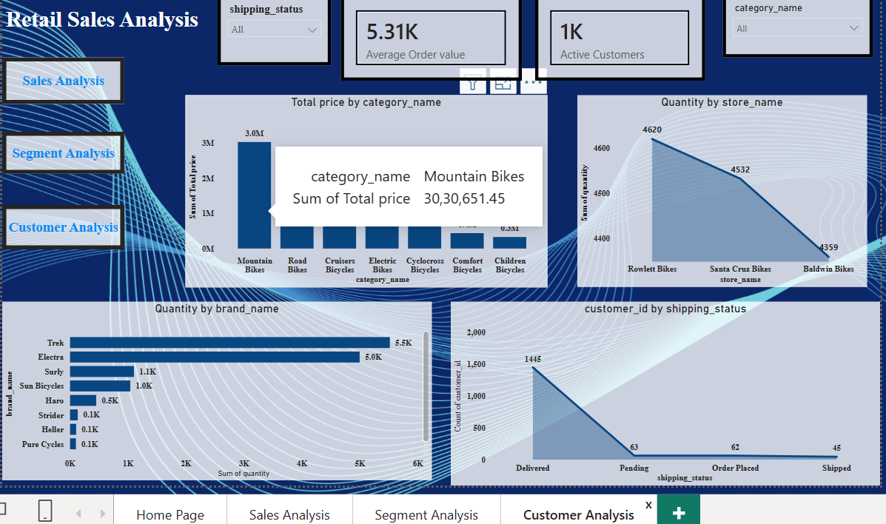

Slide 13
Key Business Insights
Top Product Category: “Mountain Bikes" appears to be a significant revenue driver.
Customer Segments: The business has a large "New" customer base, but revenue is heavily concentrated in the "At Risk" segment, suggesting a need for loyalty and re-engagement programs.
Staff Performance: Clear performance metrics can guide training and recognition programs.

Slide 14
Project Outcome
End-to-End Retail Data Analytics
Excel → Data Cleaning & Preparation
MySQL → Database Management & SQL Analysis
Python → Exploratory Data Analysis & RFM Segmentation
Power BI → Interactive Dashboard & Visualization
Key Outcome:
"We now know exactly who our best customers are, which products to push, which stores are underperforming, and when inventory is about to run out—all in one place."

Slide 15
THANK YOU

